Slide 1

Greek Literature in the Era of the
Atheno-Peloponnesian Wars (431–404 BCE)
Herodotus and His Colleagues
Spring Semester 2026
Prof. Dr. Ruobing Xian

Slide 2
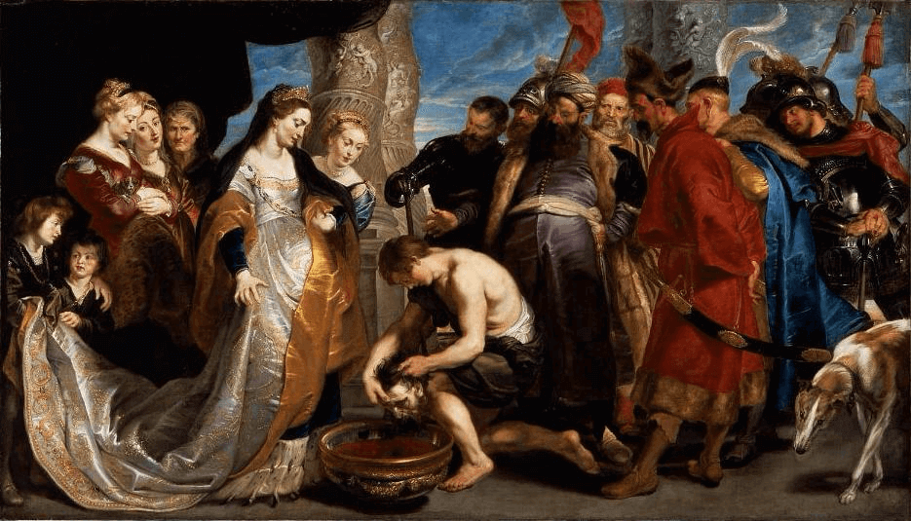
Histories Book I
1–5 Proem: the author, the contents, and the aims of the work
6–94 The Lydian logos, especially Croesus
95–216 The logos of Cyrus (the invasion of the land of the Massagetae)

Slide 3
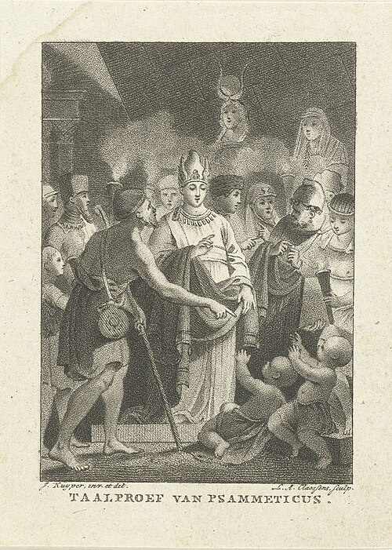
Histories Book II
1 Cambyses’ Invasion of Egypt
2–216 Egypt: Geography, People, and History
5–34 The geography and geology of Egypt
35–98 Egyptian manners and customs
99–182 The history of Egypt from Min to Amasis

Slide 4
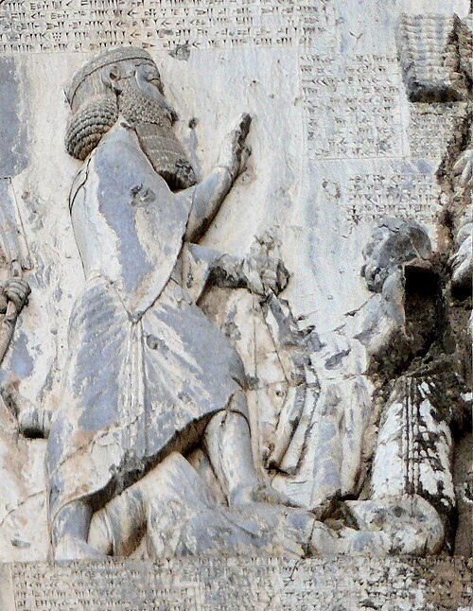
Histories Book III
1–38 The reign of Cambyses and the Persian conquest of Egypt
39–60 The first Samian logos
61–88 The revolt of the Magi and Darius’ accession to the throne
89–117 The Persian Empire
118–160 The first years of Darius’ reign

Slide 5
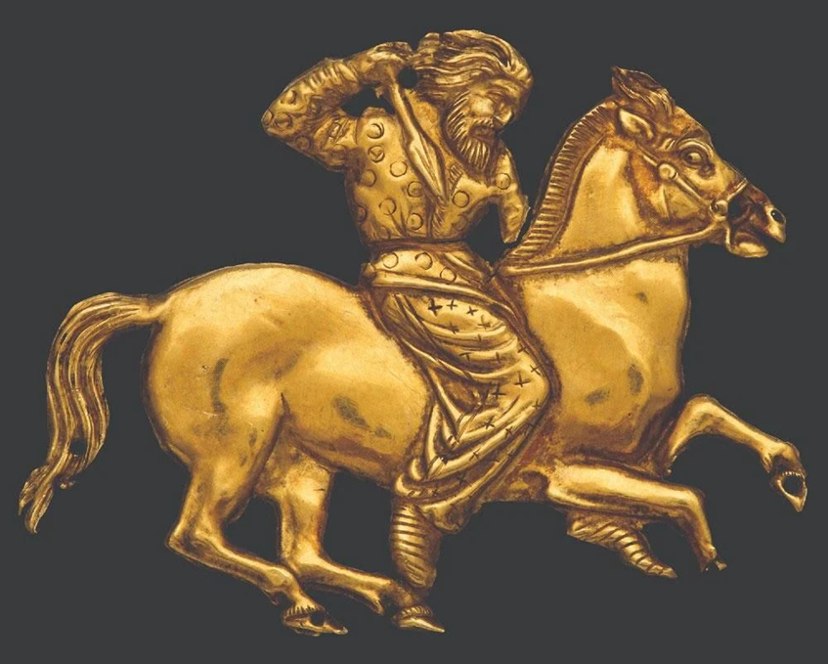
Histories Book IV
1–144 Darius’ Scythian expedition
46–82 Scythian customs
145–205 The Persian expedition to Libya
145–167 The foundation of Thera and Cyrene

Slide 6

Histories Book V
1–22 The campaign of Megabazus against Thrace and Macedonia
23–38 The beginning of the Ionian Revolt
39–54 Aristagoras seeks help in Sparta
55–97 The alliance of the Ionians with Athens
98–126 The Ionian Revolt

Slide 7
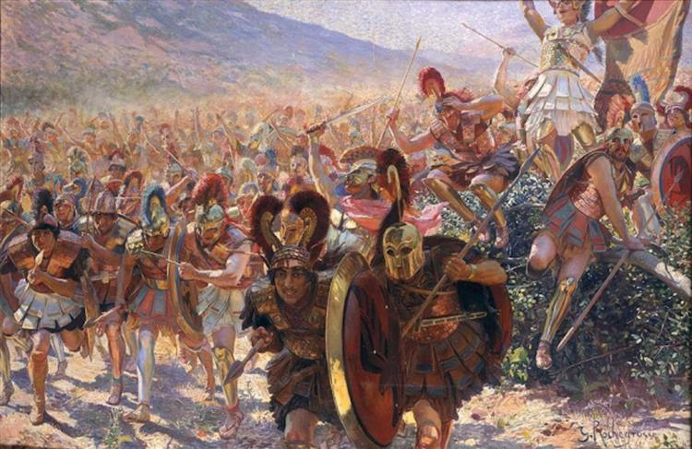
Histories Book VI
1–42 The suppression of the Ionian Revolt
43–45 The campaign of Mardonius against Greece
46–93 The political situation in Greece
94–120 The campaign of Datis and Artaphernes
103–120 The Battle of Marathon
121–131 The Alcmaeonids
132–140 The campaign of Miltiades against Paros

Slide 8
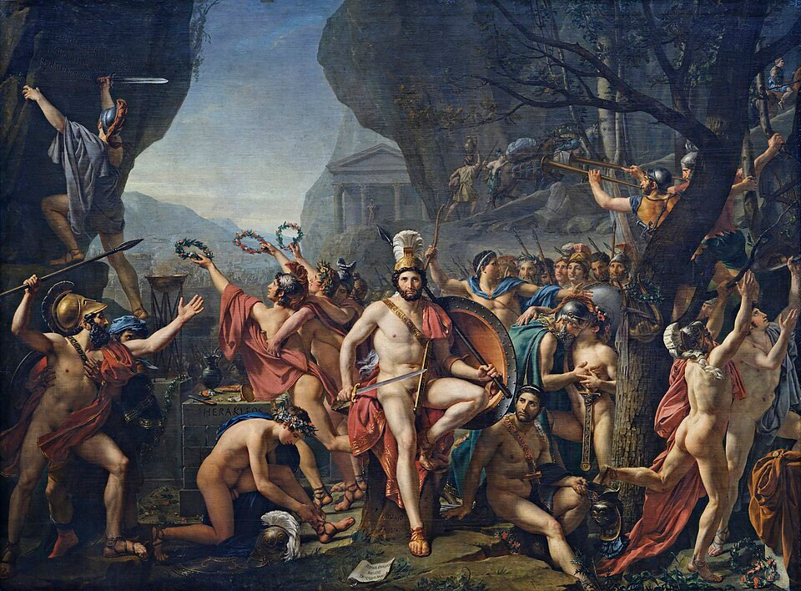
Histories Book VII
1–130 The Beginning of the Great Campaign against Greece
131–178 The Mobilization of the Hellenes
179–239 Xerxes’ Campaign up to the Battle of Thermopylae

Slide 9
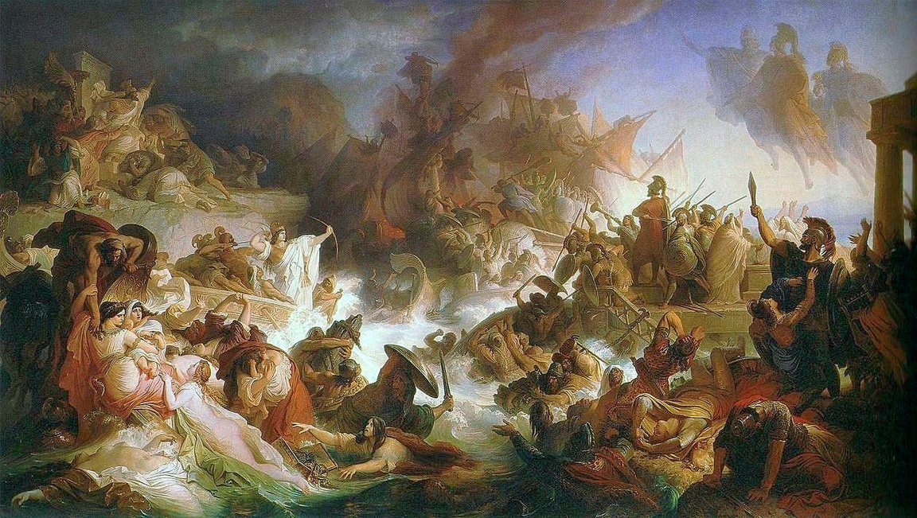
Histories Book VIII
1–129 The end of the great campaign against Greece
1–18 The Battle of Artemisium
83–96 The Battle of Salamis
113–120 Xerxes’ retreat
130–144 Preparations for the campaign of Mardonius

Slide 10
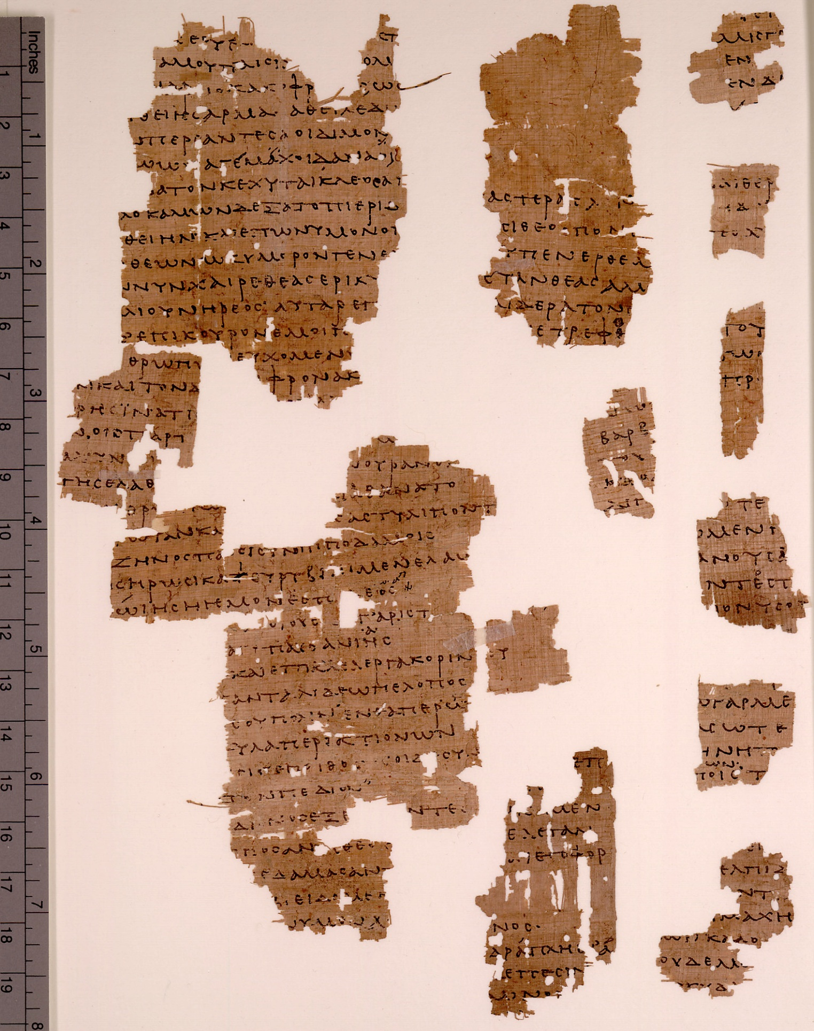
Histories Book IX
1–89 The campaign of Mardonius
1–19 The invasion of Attica and the retreat to Boeotia
58–79 The Battle of Plataea
90–121 The destruction of the Persian fleet – the liberation of Ionia
99–105 The Battle of Mycale
122 The Cyrus Anecdote

Slide 11


Thanks for your attention！
Contact: ruobingxian@fudan.edu.cn

